Slide 1
20/2/17

Slide 2
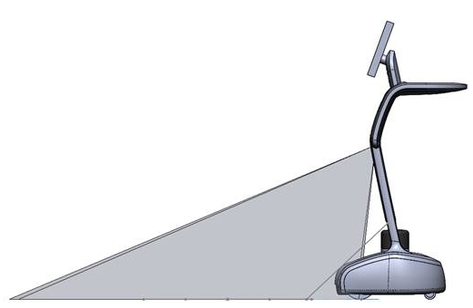
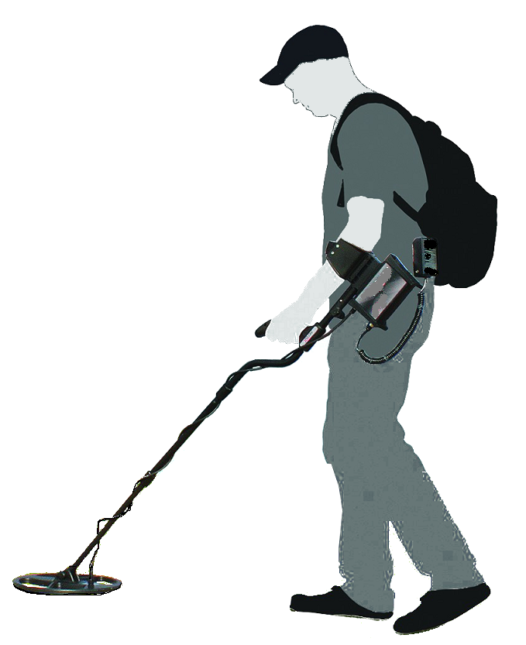

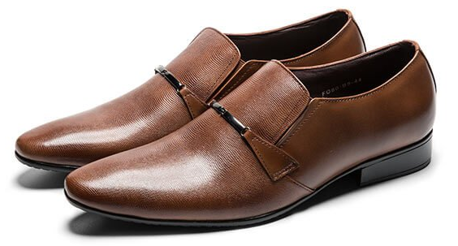
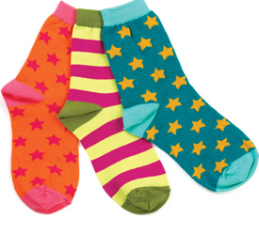
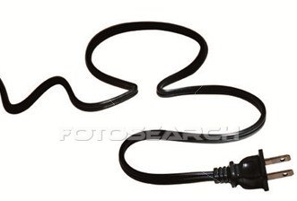
Low Obstacle Detection System-
Algorithm part

Slide 3

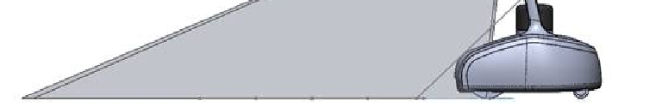

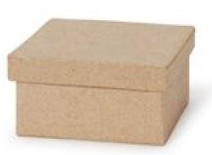
Report to main control the location of an obstacle, if detected below Lidar view.
<number>

Slide 4

Table of content
Goals.
System View.
Hardware.
Algorithm.
System potential problems and Solutions.
Final Results view.
<number>

Slide 5
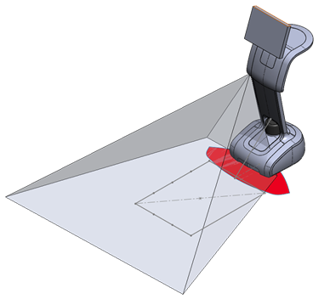
System View
Camera
Laser
Camera
Laser

Slide 6
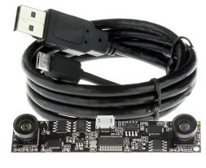
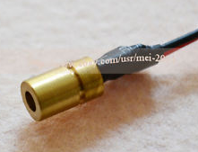
Hardware:
Dual Lens USB Camera Module OV9712 Color CMOS Sensor
Infrared IR Laser

Slide 7
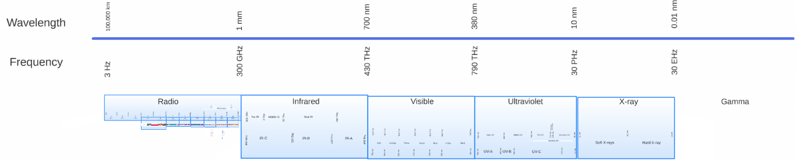
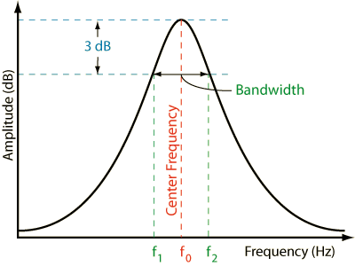
IR Laser frequency range 800 – 820 [GHz]
Camera Filter frequency range 810 – 850 [GHz]
f1 = 810 [GHz]
f2 = 850 [GHz]

Slide 8

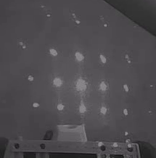
Ideal filter results
Real-life filter results

Slide 9
Laser Grid Analyzer - algorithm
Camera Read
Grey Scale
Laser Points
initial Data
out
Index <? laser cords size
Analyzing single
Laser dot

Slide 10
Analyzing single
Laser dot
Out = 1
Get mean 4 corners
Out = 0
max <? t
get max pix value
Mean <? t
dist >? t
Out = 2
Out = 0
get Roi histogram
get distance from roi centre
Get laser point centre cords
Pass 0.7*((last bin value >0%) -
(bin value >50%))
get moments
Dilation to close small gaps
findContours
0 = obstacle ; 1 = clear ; 2 = over-exposure

Slide 11
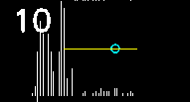
Analyzing single Laser dot – filters:
1) 4 corners mean
3) distance from centre
2) top histogram range
4) maximum pixel value

Slide 12
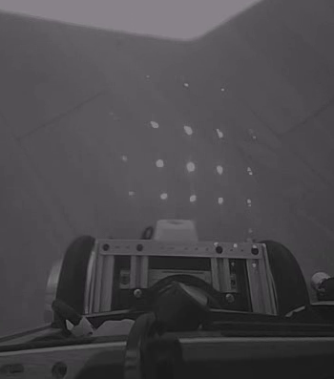
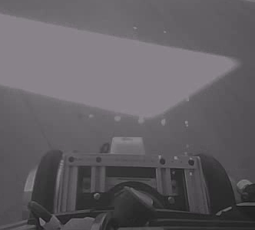
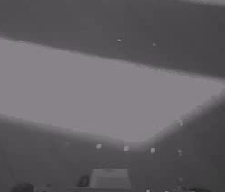
System potential problems:
1) Over exposure, due to Camera Auto Exposure

Slide 13
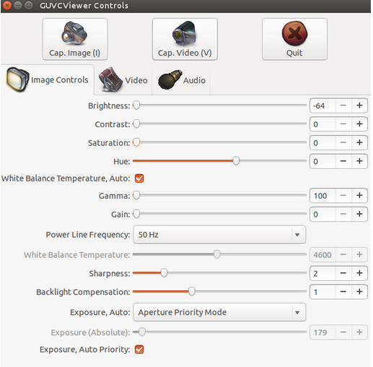

1) Solution:

Slide 14
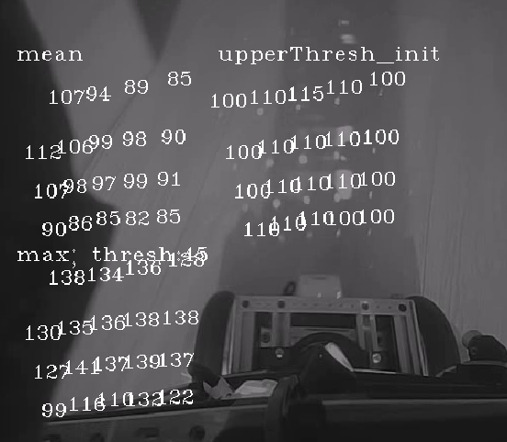


2.1) Variant floor illuminations.
Center laser shift – false alarm

Slide 15
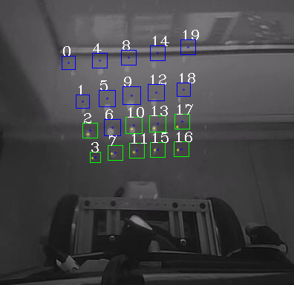
2.1) Solution
63
115
Report laser (index 6) as over-exposure, because the upper right corner mean pass the predefined threshold.
64
70

Slide 16


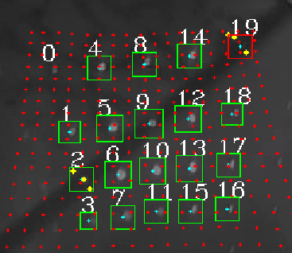


2.2) Variant floor illuminations.
Side signals too week for camera sensor detection from dark materials.
No Algorithm solution yet
2.2) Solution:
At the contour's center calculation stage: if found a center close enogth to the middle of the ROI, its probably a laser signal. And will report a clear area.

Slide 17
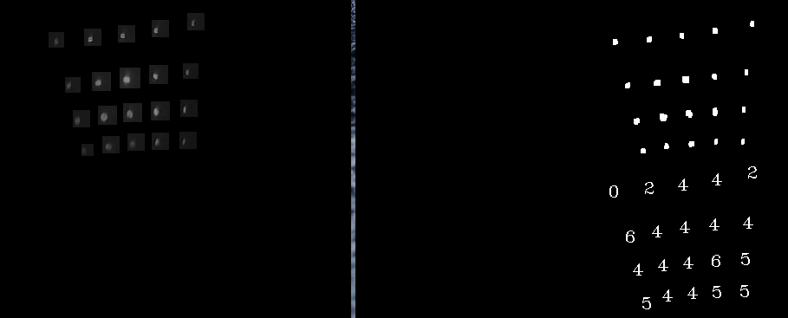
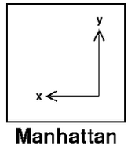

4) All Laser points - shift from the ROI centre.
Problem appear at initial state and after a 2 hours (Approximately) of operation mode.
Manhattan distance

Slide 18
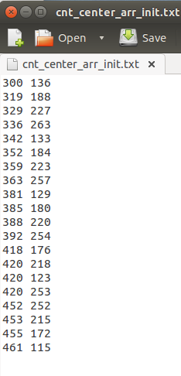
4) Solution:
Manual correct the shift of the laser dots.
changing the initial cords of the
Use “epoxy glue” to strongly attached
the camera and the laser body to the robot.

Slide 19
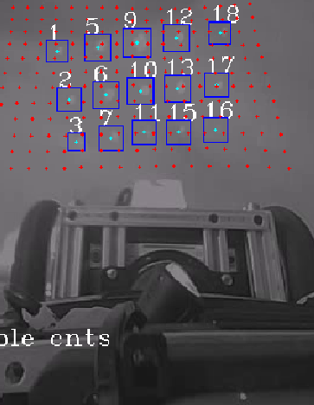
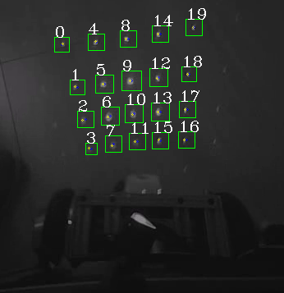
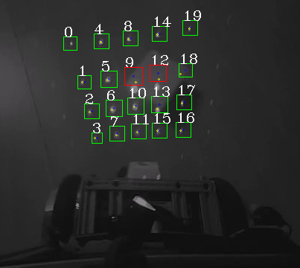
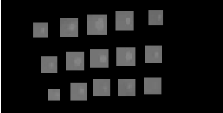
Final Results:
Clear Area
Obstacle detected
Over exposure

Slide 20
Table
Approvals
 | Title | Name | Date | Signature
Writen by |  | Bental Tavor | 20.2.17
Approved by
Total:
<number>

Slide 21
Thank you

